Slide 1
Question Paper bank
Mini Project Presentation
By Prashant Sangule & Pritam Pokale

Slide 2
Abstract
Our project Question paper Bank Portal provides a study platform to IT Students, includes registrations of students, storing their details into the system. Our website has facility to give a unique ID for every Student and storing the details of every students automatically. On question paper bank portal student can register using their name, email-Id, Phone-No, Class and Semester. We only take Students information just to provide their ongoing semesters previous question paper, Student can only see their ongoing semester question papers but they can’t access to other question papers.
Our Facility includes every semester question papers, so the students can get their question paper as per their requirement. Our data Processing is very fast. Student can access question paper bank entered using only username and password. So they can retrieved their data easily. Our question paper bank portal interface is user-friendly. Your data is well protected for your personal use. Our Question paper bank provides question paper to computer department students like BCS, B.Sc(I.T), BCA(Sci).

Slide 3
Existing System
Old syllabus.
Time consuming.
Consumes large volume of paper work.

Slide 4
Proposed System
User friendliness and interactive.
Minimum time required for study.
Updated syllabus
Latest Questions

Slide 5
Conclusion
Our website allows students to ask queries via contact us page and then get solutions for their queries regarding the question papers. Question paper bank is the best option to study the previous year questions, because it has no fees for the papers and it is easily accessible from anywhere in the world.
Question paper bank has question papers for three academic courses in Dr. B. A. M. University, namely B.Sc(I.T.), BCA,BCS(Sci.).

Slide 6
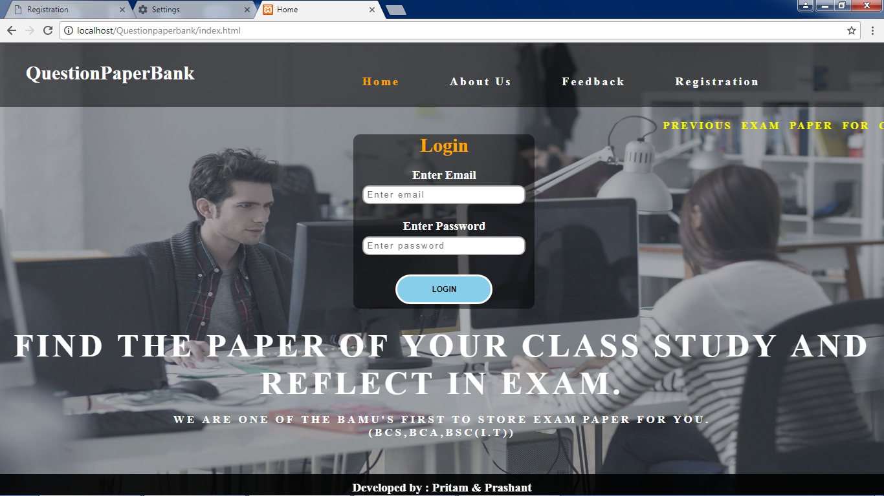
Homepage

Slide 7
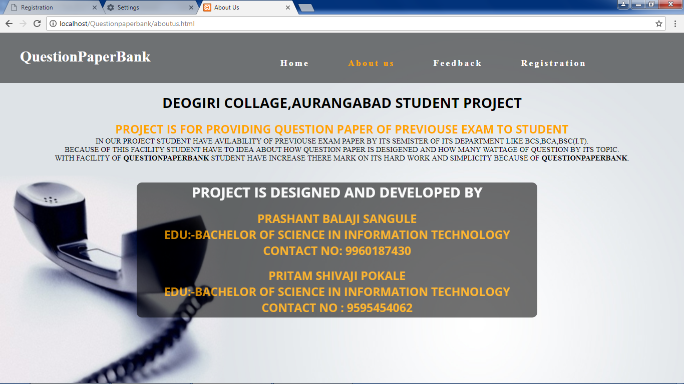
About Us

Slide 8
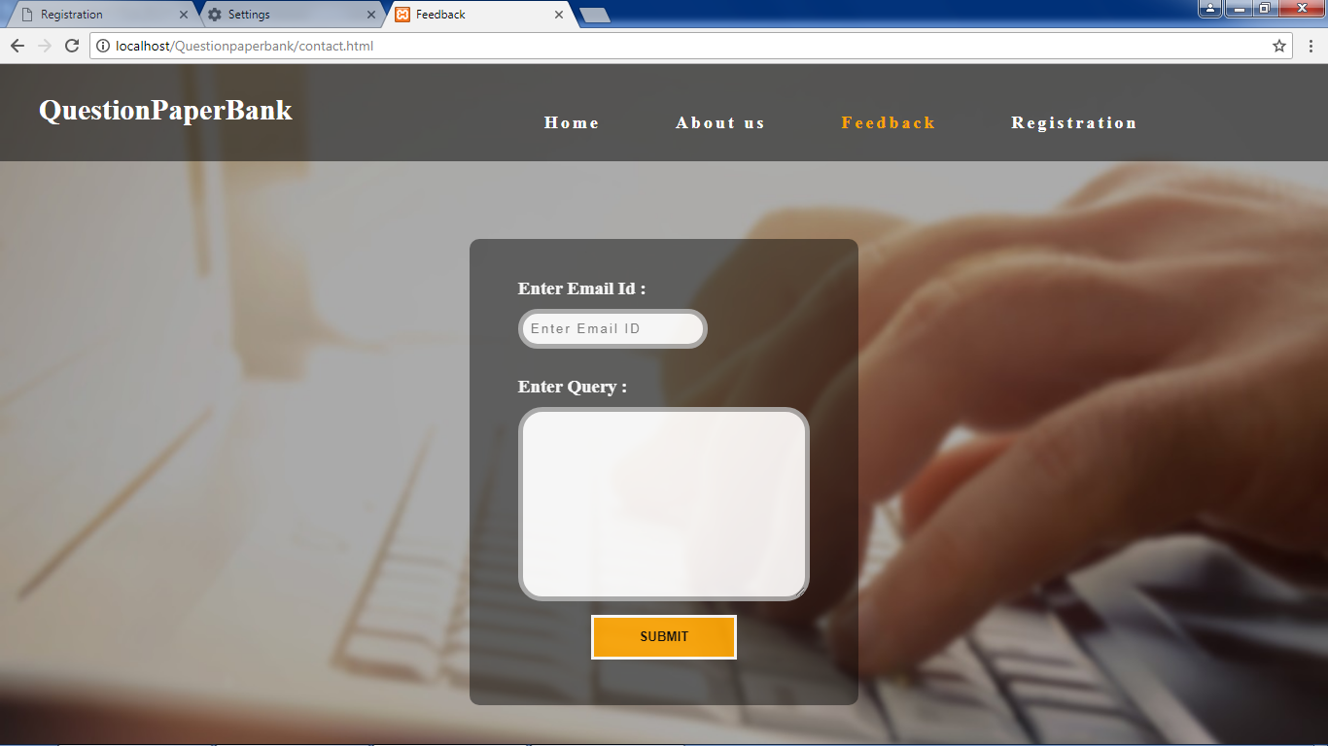
Feedback

Slide 9
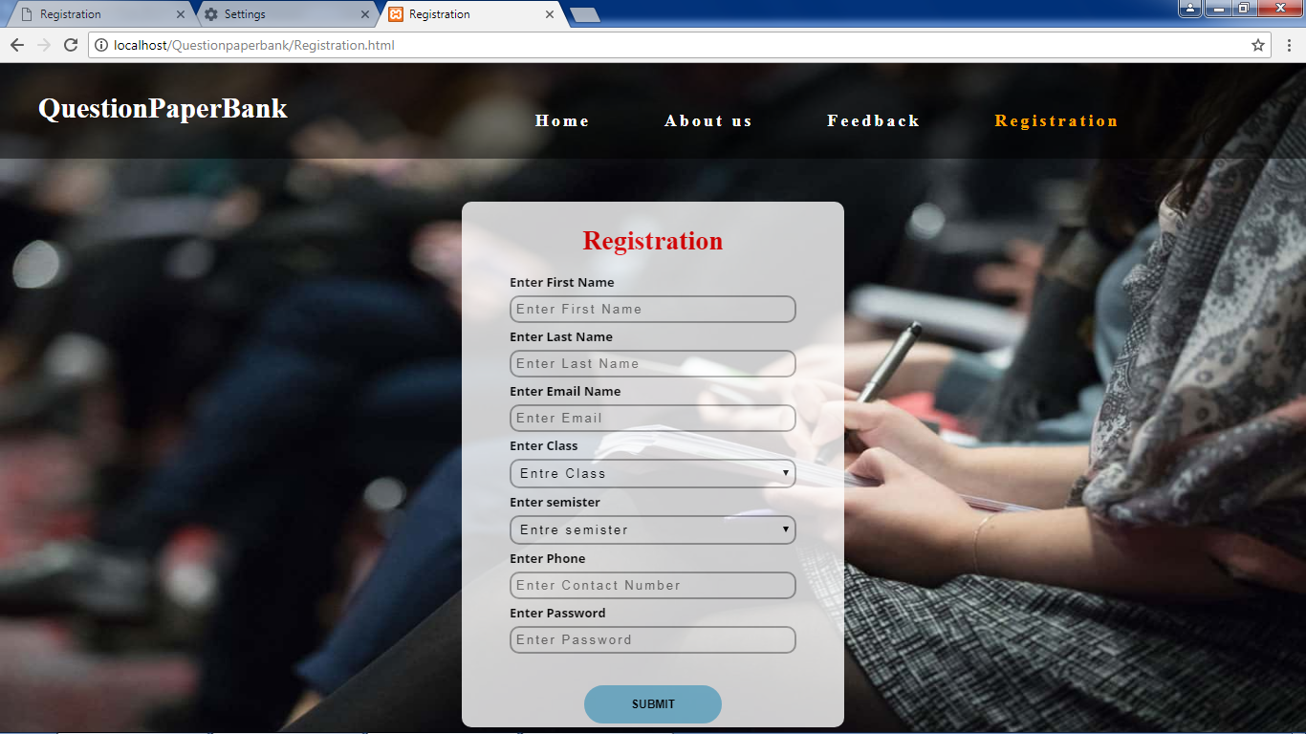
Registration

Slide 10
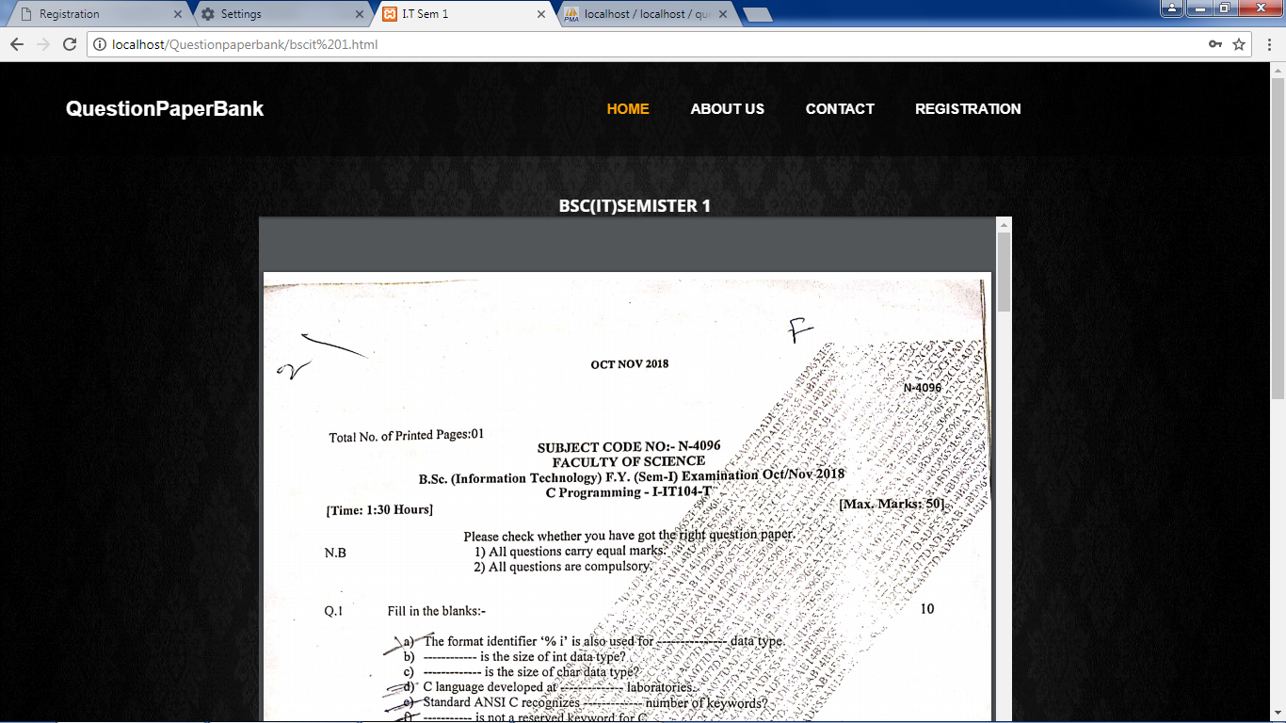
User Home

